Slide 1
Mental Health Tips
Minitheme
October, 10
Here is where your presentation begins

Slide 2
01.
About the project
You can enter a subtitle here if you need it

Slide 3
Contents of this template
This is a slide structure based on a minitheme presentation
You can delete this slide when you’re done editing the presentation
Fonts | To view this template correctly in PowerPoint, download and install the fonts we used
Used and alternative resources | An assortment of graphic resources that are suitable for use in this presentation
Thanks slide | You must keep it so that proper credits for our design are given
Colors | All the colors used in this presentation
Infographic resources | These can be used in the template, and their size and color can be edited
Customizable icons | They are sorted by theme so you can use them in all kinds of presentations
For more info:
SLIDESGO | SLIDESGO SCHOOL | FAQS
You can visit our sister projects:
FREEPIK | FLATICON | STORYSET | WEPIK | VIDFY

Slide 4
Introduction
You can give a brief description of the topic you want to talk about here. For example, if you want to talk about Mercury, you can say that it’s the smallest planet in the entire Solar System

Slide 5
Table of contents
1
2
3
4
Evolution
Mental Disorders
You can describe the topic of the section here
You can describe the topic of the section here
Common Disorders
Potential Solutions
You can describe the topic of the section here
You can describe the topic of the section here

Slide 6
The slide title goes here!
Do you know what helps you make your point clear?
Lists like this one:
They’re simple
You can organize your ideas clearly
You’ll never forget to buy milk!
And the most important thing: the audience won’t miss the point of your presentation

Slide 7
Mental Disorders
You can describe the topic of the section here
Mercury
It’s the closest planet to the Sun
Venus
Venus is the second planet from the Sun
Mars
Mars is actually a very cold place

Slide 8
Evolution Mental Health
Factors
Treatment
Disorders
Recovery
Venus is the second planet from the Sun
Earth is the only planet known to harbor life
Jupiter is the biggest planet in the Solar System
Neptune is the farthest planet from the Sun

Slide 9
Mental Health affects to…
Mental Health
Physical Health
Mercury is the closest planet to the Sun and the smallest one in the Solar System. This planet’s name has nothing to do with the liquid metal
Venus has a beautiful name and is the second planet from the Sun. It’s hot and is the second-brightest natural object in the night sky

Slide 10
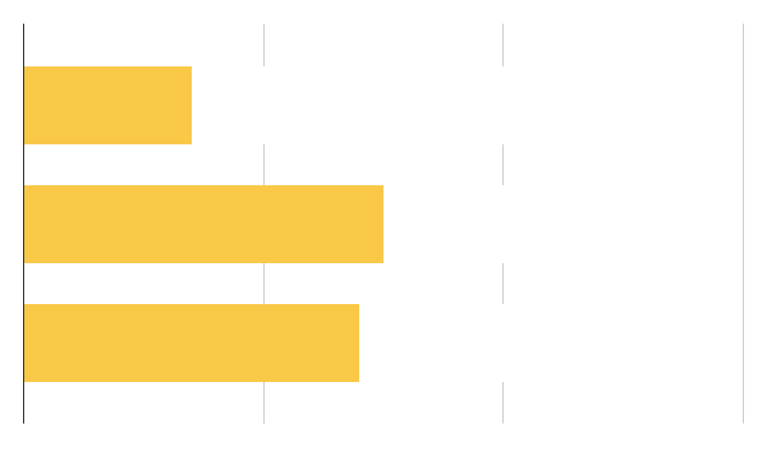
Most Common Disorders
Panic
Anxiety
Depression
Age 15-30
Age 30-55
Mercury is the smallest planet in the Solar System
Venus is the second planet from the Sun
Despite being red, Mars is actually a cold place
Follow the link in the graph to modify its data and then paste the new one here. For more info, click here

Slide 11
This is a map
Mercury
It’s the closest planet to the Sun
Saturn
It’s composed of hydrogen and helium
Jupiter
Jupiter is the biggest planet of them all

Slide 12
Reviewing concepts is a good idea
Mercury
Venus
Mars
It’s the closest planet to the Sun
Venus is the second planet from the Sun
Mars is actually a very cold place
Jupiter
Saturn
Neptune
Jupiter is the biggest planet of them all
It’s composed of hydrogen and helium
It’s the farthest planet from the Sun

Slide 13
70-90%
<
of people who seek proper treatment
for mental health disorders witness
a significant reduction in symptoms

Slide 14
9h 55m 23s
333,000
386,000 km
Jupiter's rotation period
The Sun’s mass compared to Earth’s
Distance between Earth and the Moon

Slide 15
Tips to start
Tip 1
Tip 2
Tip 3
Mercury is the closest planet to the Sun and the smallest of them all
Venus has a beautiful name, but also high temperatures
Jupiter is a gas giant and the biggest planet in the Solar System

Slide 16
Tips Checklist
Tip name | Description | I do it!
Tip 1 | Venus is the second planet from the Sun
Tip 2 | Despite being red, Mars is a cold place
Tip 3 | It’s the biggest planet in the Solar System
Tip 4 | Saturn is a gas giant and has several rings

Slide 17
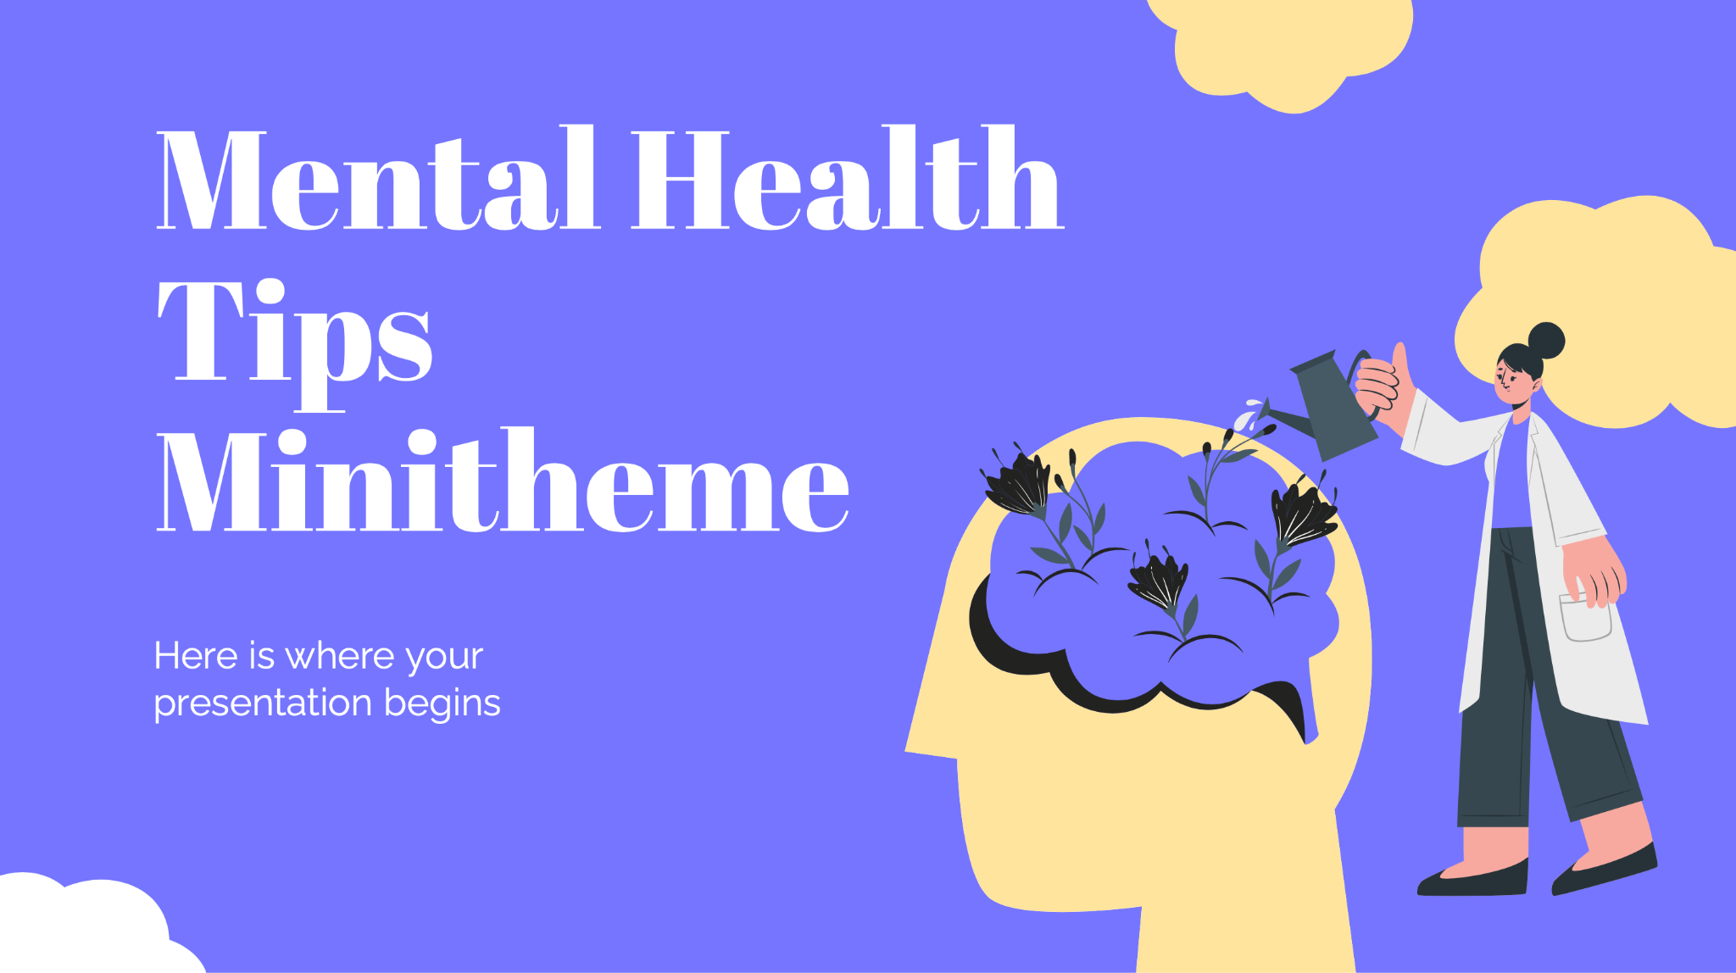
Desktop Software
You can replace the image on the screen with your own work. Just right-click on it and select “Replace image”

Slide 18
Thanks!
Do you have any questions?
youremail@freepik.com
+91 620 421 838
yourwebsite.com
Please keep this slide for attribution

